Slide 1
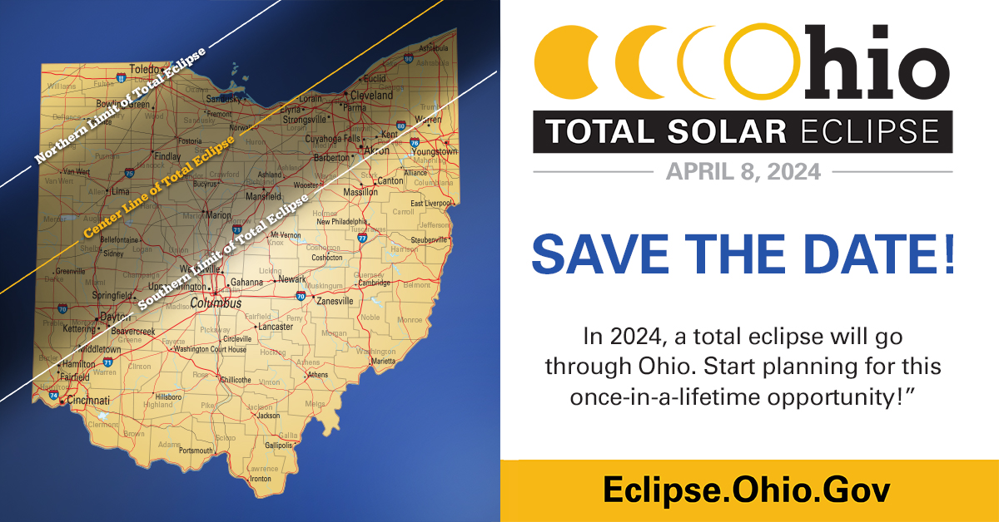

Slide 2
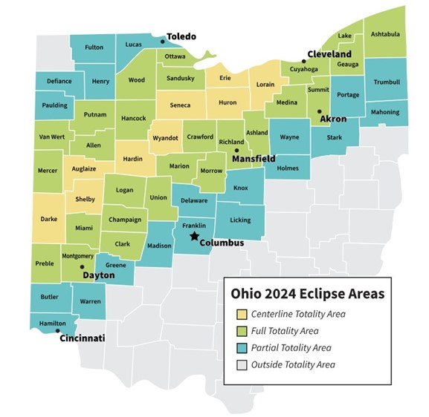

Slide 3
SOLAR ECLIPSE
April 8, 2024
State of Ohio Official Site for Solar Eclipse
Ohio Department of Health
Suppliers of Safe Solar Viewers and Filters
NASA
Websites include list of resources, timelines, maps, tips for preparation.
Tune into local news regarding school/business closings.
Review your Emergency Preparedness Policies.

